Slide 1
Topic 7
DHCP and NAT

Slide 2



Dynamic Host Configuration Protocol (DHCP)
IP address assignment
Default Gateway assignment
Network services discovery
I just booted.
What network is this?
What is the gateway?
DHCP Server
Host A VLAN 30
Where is the TFTP Server?
Phone A VLAN 40

Slide 3
DHCP Process
Host issues a DHCP discover message to any available server.
Server(s) replies back with DHCP offer message.
Client issues DHCP request using offered IP.
Server replies with DHCP acknowledgement indicating lease time and other options requested by the client.

Slide 4
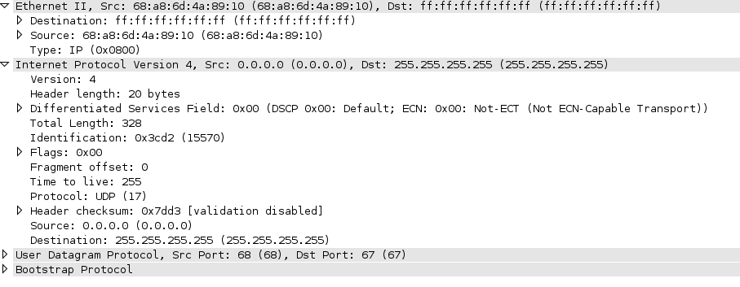
DHCP Packet Quick Look
Note that destination MAC and IP is all broadcast

Slide 5
IOS DHCP Configuration Example
Create a DHCP pool.
  ip dhcp pool (pool_name)
Assign a network and default router to the pool.
  network 10.1.1.0 255.255.255.0
  default-router 10.1.1.1
Assign additional options if required.
  dns-server 10.40.1.51
  option 150 ip 10.40.1.99

Slide 6
Infrastructure DHCP Configuration Example
Remove any conflicting pool from the router
  no ip dhcp pool (pool_name)
Enter interface configure mode for the required interface and configure broadcast relay.
  interface vlan 30
  ip helper-address 10.40.1.51

Slide 7
Helpful Commands
show ip dhcp binding
clear ip dhcp binding (address or *)
debug ip dhcp server packet

Slide 8

Network Address Translation (NAT)
Address Depletion
Migration/Mergers
Server load sharing
Changing ISP
IOS Firewall
Internet

Slide 9
Types of NAT
Static NAT – one-to-one mapping between local and global addresses.
Dynamic NAT – many-to-many mapping between local and global addresses by using a pool of real IP addresses.
Overloading (PAT) – many-to-one local to global mapping using a real IP’s transport layer ports.

Slide 10
NAT Address Names
Inside Local – inside source address before translation.
Outside Local – destination host before translation.
Inside Global – inside host after translation.
Outside Global – outside destination host after translation.

Slide 11

Dynamic and Static NAT
NAT TABLE
Inside Local
Inside Global
10.1.1.1
10.1.1.2
10.1.1.3
170.168.2.2
170.168.2.3
170.168.2.4
Inside
SA
10.1.1.1
64.40.7.3
10.1.1.1
DA
170.168.2.2
SA
170.168.2.2
DA
10.1.1.1
10.1.1.2
Internet
IOS Firewall
10.1.1.3

Slide 12
Overloading (PAT)
Protocol
Inside Local
Inside Global
Outside Global
TCP
TCP
TCP
10.1.1.1:1721
10.1.1.2:1024
10.1.1.3:1723
170.168.2.2:1493
170.168.2.2:1723
170.168.2.2:1024
61.40.7.3:23
61.40.7.3:23 61.40.7.3:23
Inside
SA
10.1.1.1
64.40.7.3
10.1.1.1
DA
170.168.2.2:1493
SA
170.168.2.2:1493
10.1.1.2
DA
10.1.1.1
Internet
IOS Firewall
10.1.1.3

Slide 13
Static NAT config example
ip nat inside source static 10.1.1.1 170.46.2.2
interface ethernet0/0
  ip address 10.1.1.10 255.255.255.0
  ip nat inside
interface serial0/0
  ip address 170.46.2.1 255.255.255.0
  ip nat outside
S0/0
outside
E0/0
inside
Internet
10.1.1.1

Slide 14
Dynamic NAT config example
ip nat pool globalnet 170.168.2.2 170.168.2.254 netmask 255.255.255.0
ip nat inside source list 1 pool globalnet
interface ethernet0/0
  ip address 10.1.1.10 255.255.255.0
  ip nat inside
interface serial0/0
  ip address 170.68.2.1 255.255.255.0
  ip nat outside
access-list 1 permit 10.1.1.0 0.0.0.255
S0/0
outside
E0/0
inside
Internet

Slide 15
PAT (overloading) config example
ip nat pool globalnet 170.168.2.1 170.168.2.1 netmask 255.255.255.0
ip nat inside source list 1 pool globalnet overload
interface ethernet0/0
  ip address 10.1.1.10 255.255.255.0
  ip nat inside
interface serial0/0
  ip address 170.68.2.1 255.255.255.0
  ip nat outside
access-list 1 permit 10.1.1.0 0.0.0.255
S0/0
outside
E0/0
inside
Internet

Slide 16
Miscellaneous
Troubleshooting commands
  show ip nat translation
  clear ip nat translation *
  debug ip nat

